Slide 1
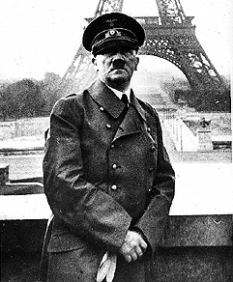
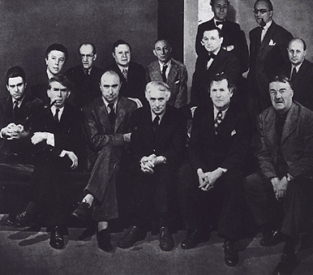
(left) Hitler occupies Paris, 1940
(right) Artists in the Artists in Exile show at the Pierre Matisse Gallery, New York, March 1942
Left to right, first row: Matta, Ossip Zadkine, Yves Tanguy, Max Ernst, Marc Chagall, Fernand Léger; second row: André Breton, Piet Mondrian, André Masson, Amédée Ozenfant, Jacques Lipchitz, Pavel Tchelitchew, Kurt Seligmann, Eugene Berman
THE END OF THE AGE OF EUROPE AND EMERGENCE OF NEW YORK SCHOOL

Slide 2
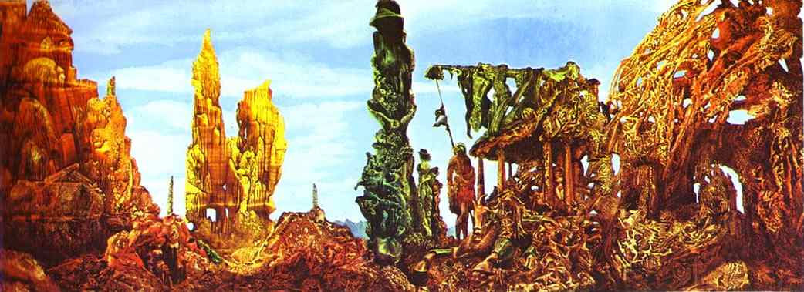
Max Ernst, Europe After the Rain, 1940-42, oil on canvas, 21 x 58”
Surrealist automatist technique of decalcomania, which involves pressing paint between two surfaces

Slide 3
American Abstract Expressionism
“The New York School”
After World War Two New York City
replaces Paris as the capital of the art world

Slide 4
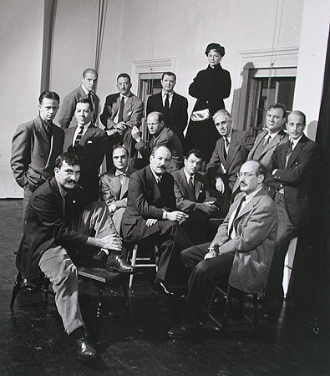
“The Irascibles” (Abstract Expressionists), Life Magazine cover story, 1951
Theodoros Stamos, Jimmy Ernst, Barnett Newman, James Brooks, Mark Rothko, Richard Pousette-Dart, William Baziotes, Jackson Pollock, Clyfford Still, Robert Motherwell, Bradley Walker Tomlin, Willem de Kooning, Adolph Gottlieb, Ad Reinhardt, Hedda Sterne

Slide 5
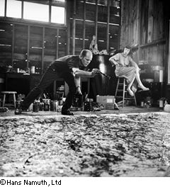
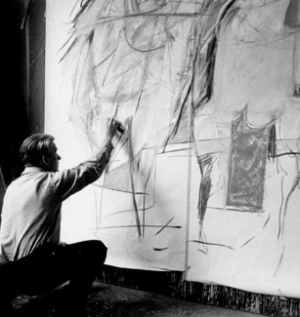
ABSTRACT EXPRESSIONIST ACTION PAINTING
(left) Jackson Pollock (US, 1912-1956) painting, 1950
(right) Willem de Kooning (US, born Holland,1904–97) painting Woman I, 1951

Slide 6
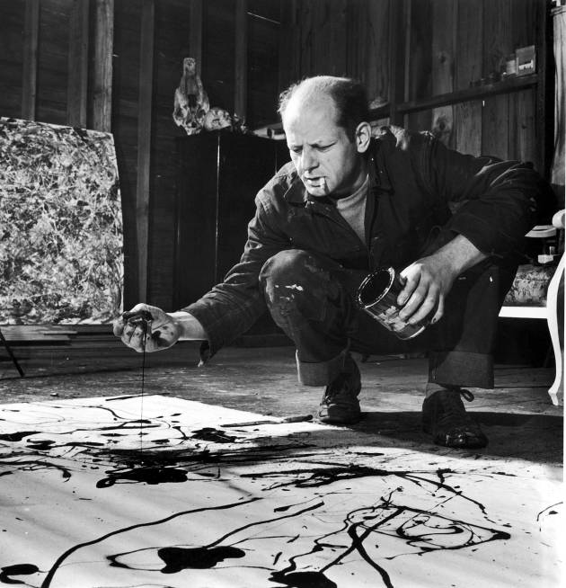
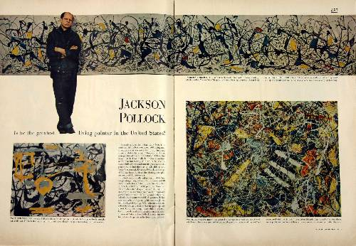
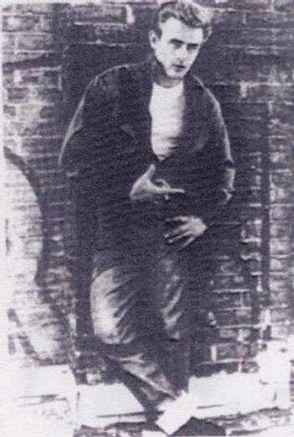
Jackson Pollock (American, 1912-1956) painting in Springs NY studio, 1950
Action Painting – American Abstract Expressionism
“I believe the easel picture to be a dying form.” (Guggenheim Application, 1947)
James Dean in
Rebel Without a
Cause, 1955
August 1949 issue of Life magazine: ”Is he the greatest living painter in the United States?”
Jackson Pollock is the first artist to become a media celebrity

Slide 7
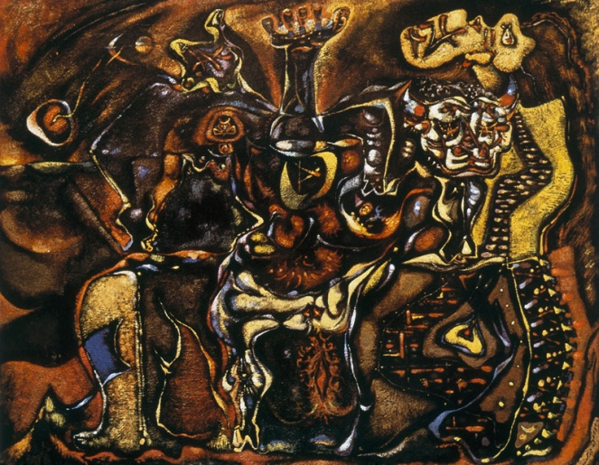
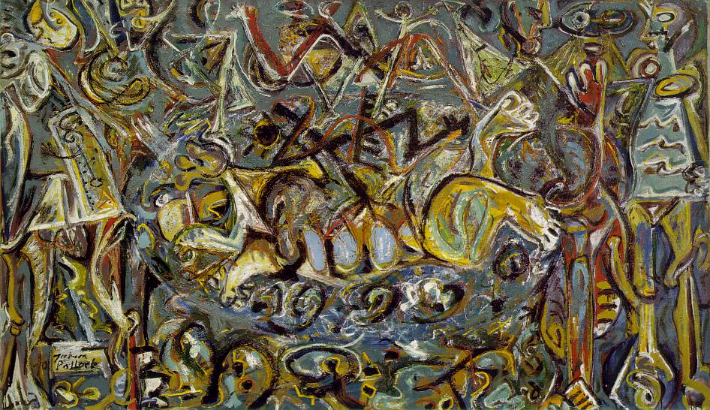
(below) Jackson Pollock, Pasiphae, 1943
(right) André Masson (French Surrealist), Pasiphae, 1943
Surrealism (subjective mythos and automatism) and Jungian psychoanalysis: the collective unconscious

Slide 8
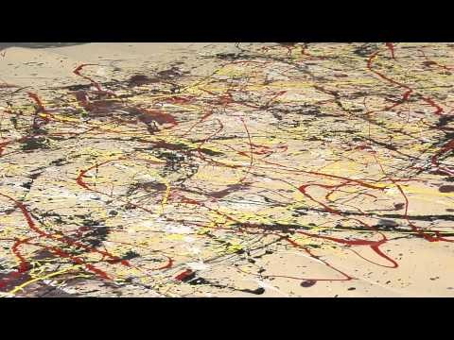

Slide 9
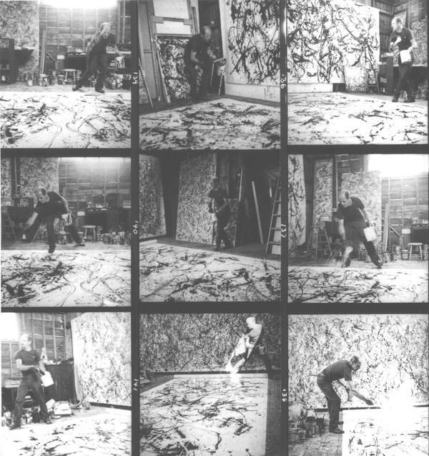
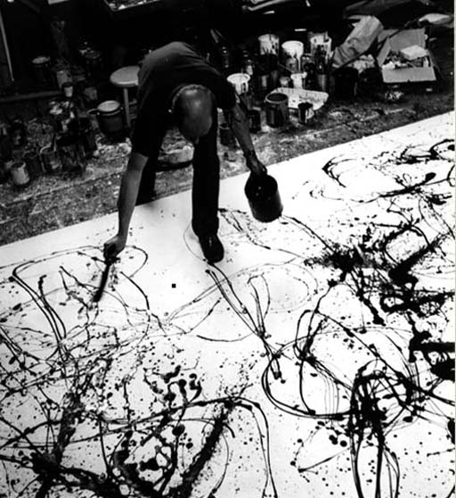
Hans Namuth, photographs and film stills of Pollock Painting, 1951

Slide 10
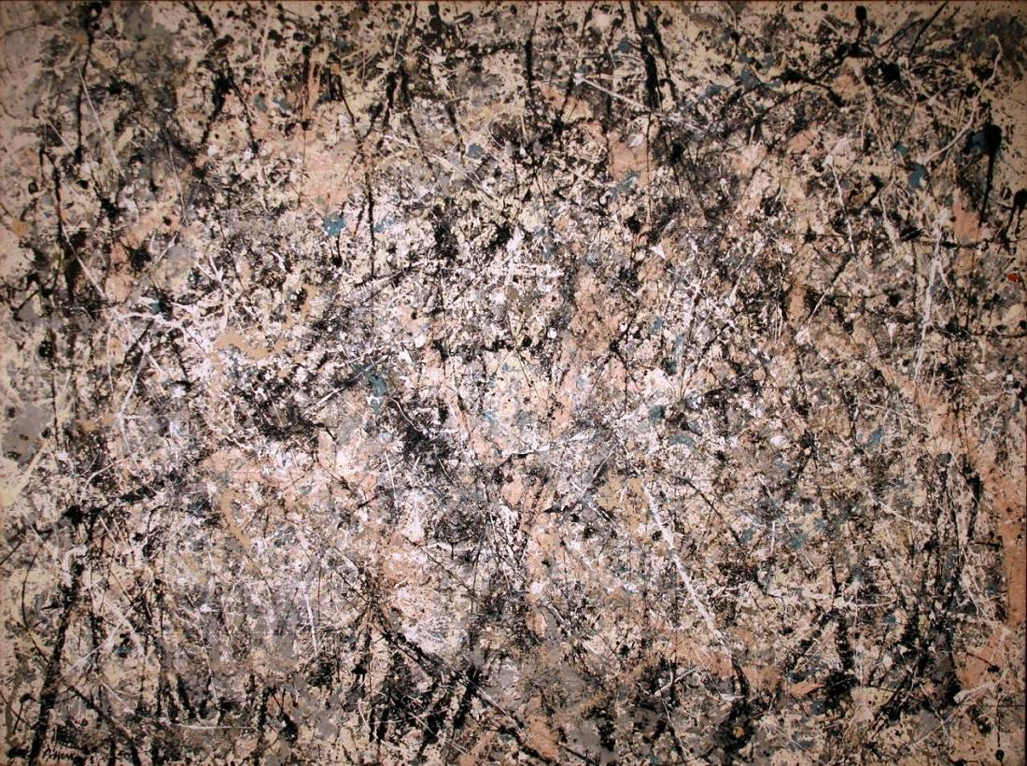
Jackson Pollock, Number 1, 1950 (Lavender Mist),1950, oil, enamel, and aluminum on canvas, 7’ 3” x 9’10 “, National Gallery of Art, Washington, D.C.

Slide 11
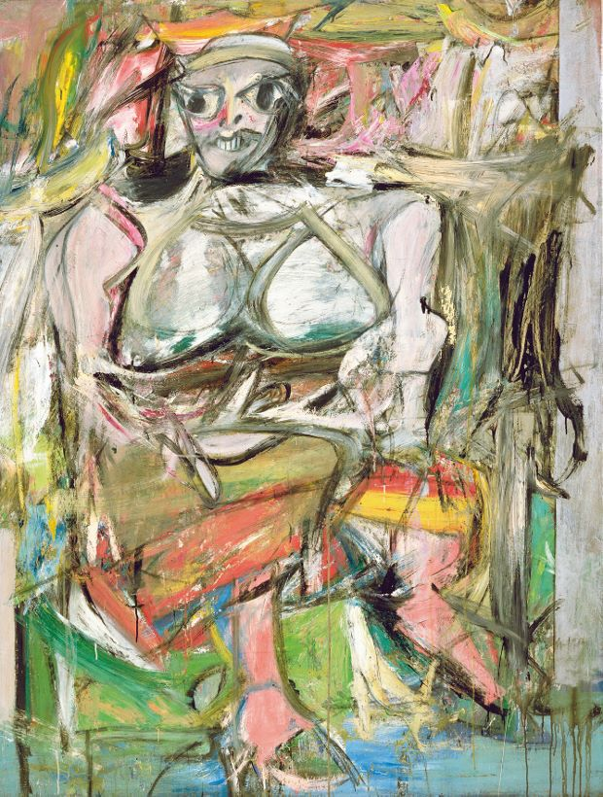
(above) Willem de Kooning making an early study for Woman I, c.1950
(right) Woman I, oil on canvas, 1950-2, 6' 3 7/8" x 58“ Abstract Expressionist Action Painting
"Flesh is the reason oil paint was invented."

Slide 12
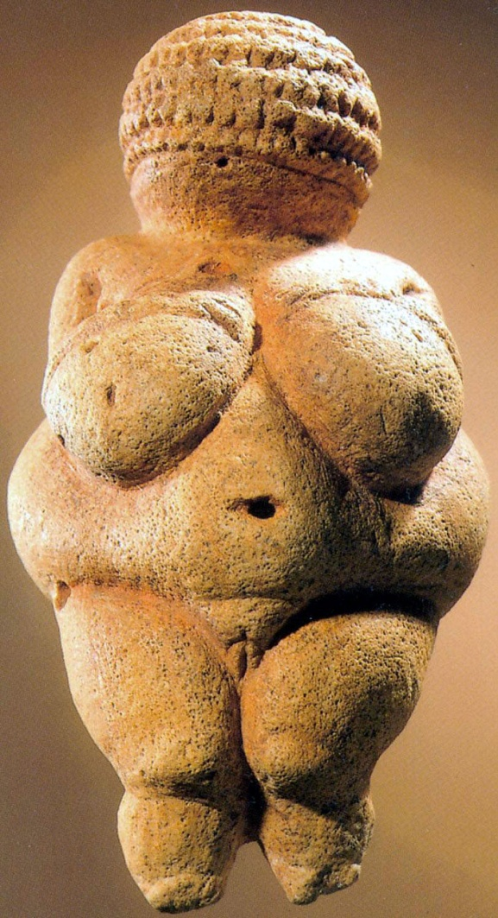
Willem de Kooning, Woman I, 1950-2
(above) Venus of Willendorf, limestone, painted with ochre, 4 3/4 inches, ca. 25,000 years old

Slide 13
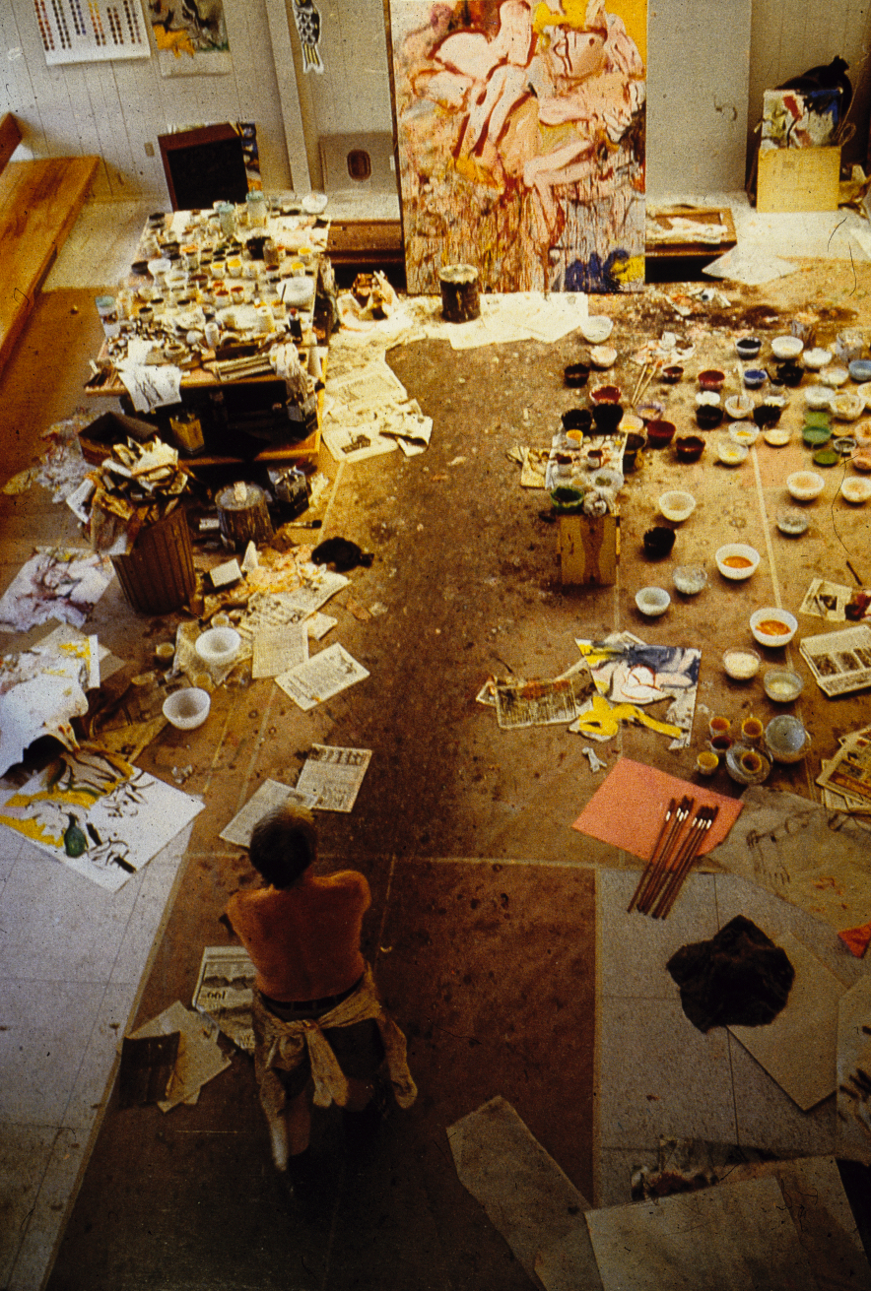
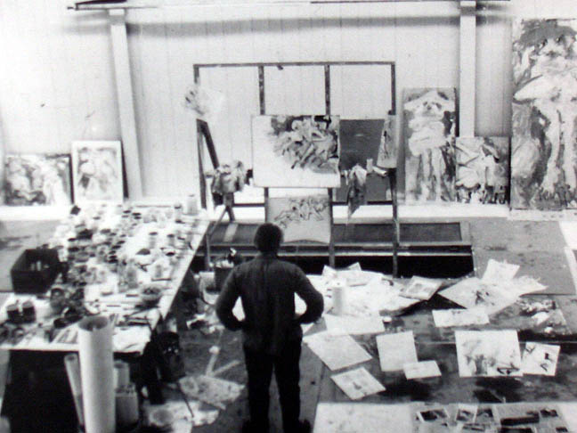
De Kooning in studio, Springs, NY, 1960s

Slide 14
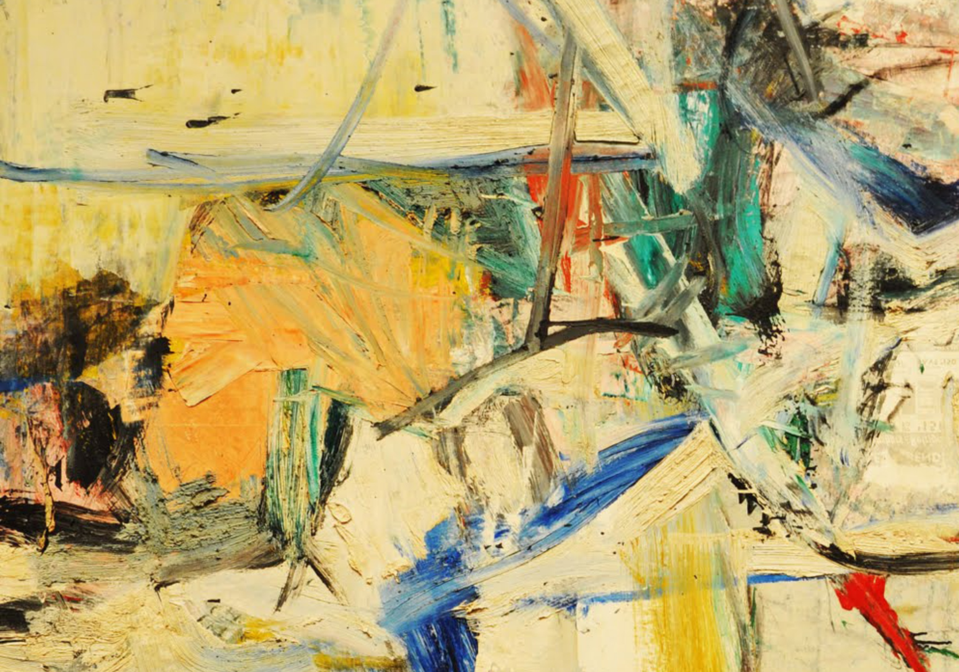

Slide 15
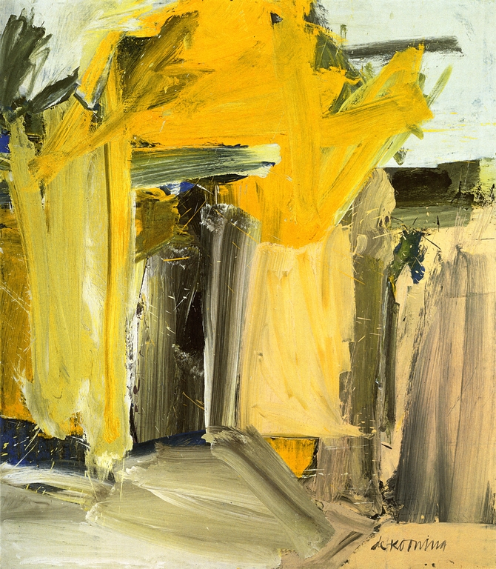
Willem de Kooning, Door to the River, 1960, oil on linen, 80 × 70 in

Slide 16
American Abstract Expressionism
Chromatic Expressionism
Painters of the Sublime
Mark Rothko

Slide 17
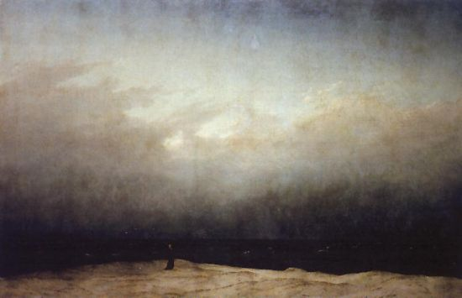
Caspar David Friedrich (German, 1774 -1840), Monk by the Seashore, 1809-10, German Romantic Sublime

Slide 18
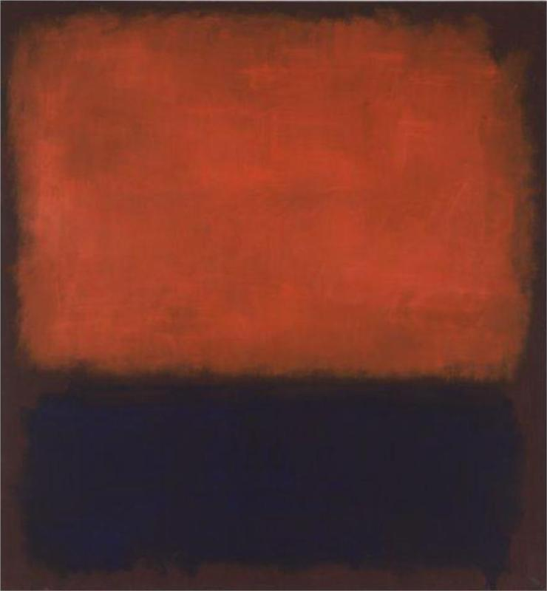
Mark Rothko, No. 14, 1960, o/c, 9.48 x 9.70 ft, SFMoMA

Slide 19
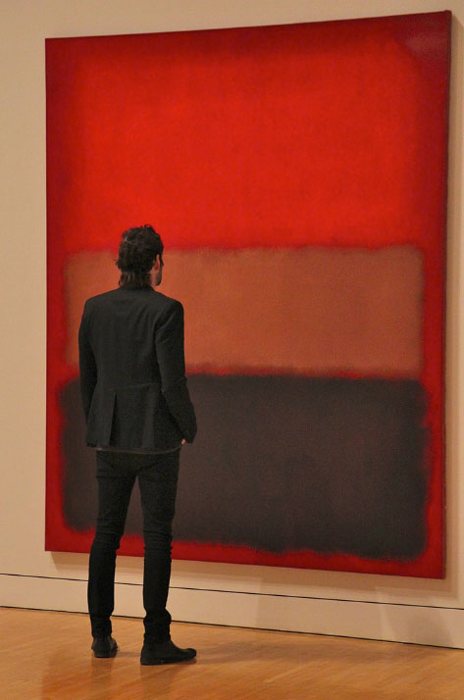
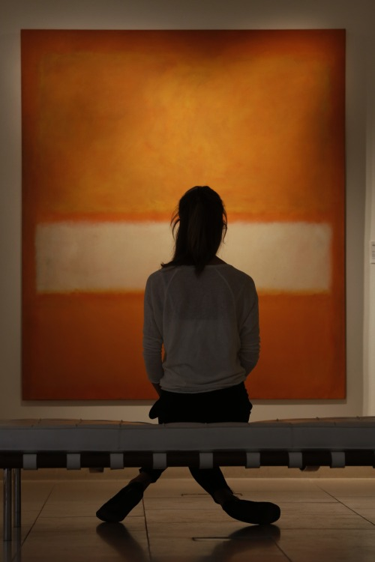
"The people who weep before my pictures are having the same religious experience I had when I painted them." Mark Rothko

Slide 20
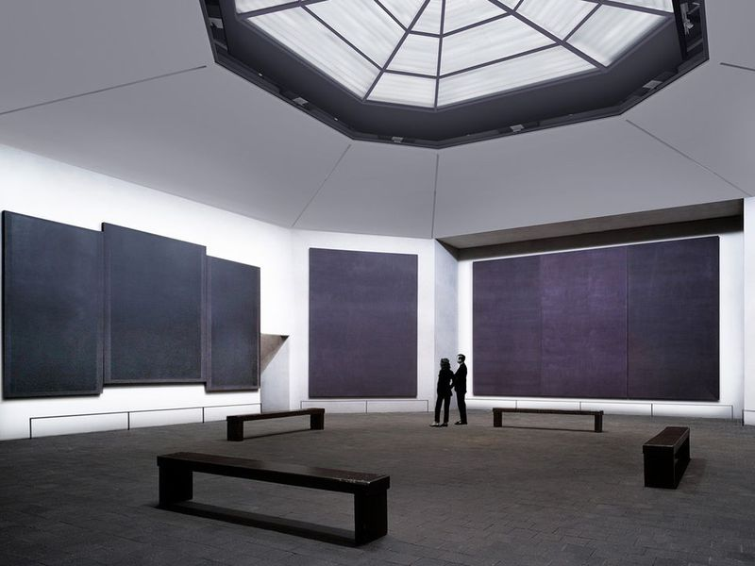
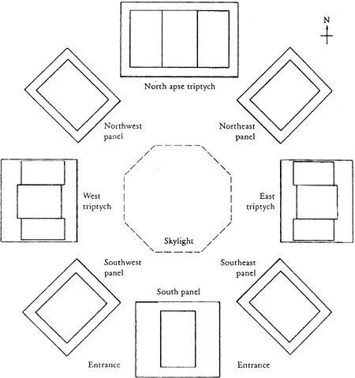
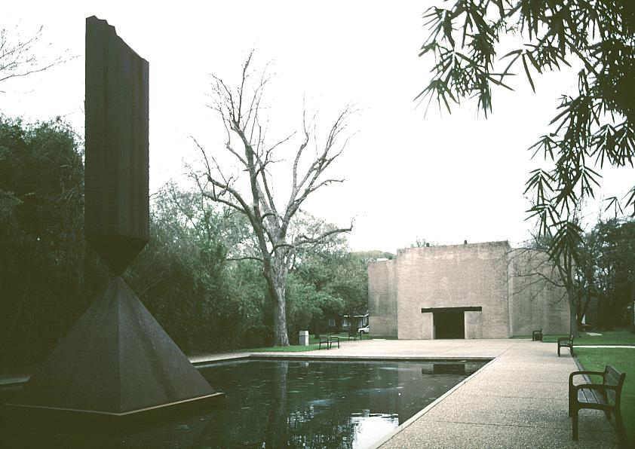
Rothko Chapel suite of paintings, 1965-66, De Menil Collection, Houston, Texas, 1970
“I wanted to paint both the finite and the infinite….
I was always looking for something more.” \
Rothko Chapel exterior

Slide 21
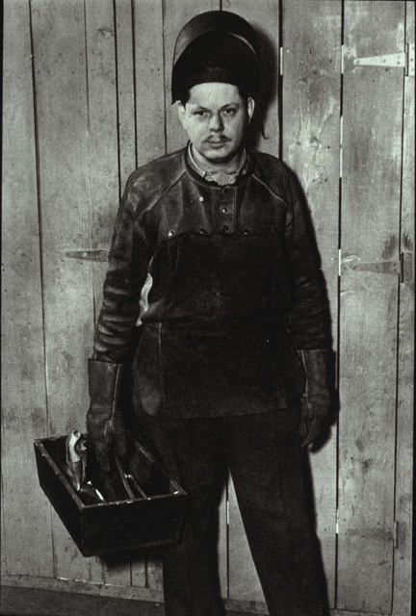
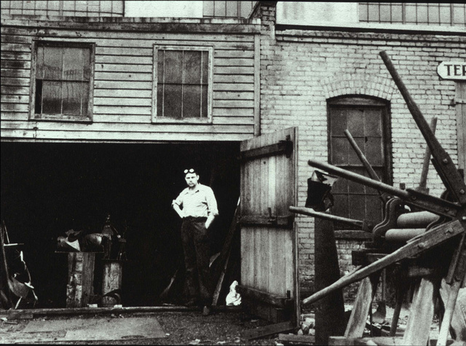
David Smith (U.S., 1906 -1965) Abstract Expressionist sculptor
Artist at the former “Terminal Iron Works, Boiler-Tube Makers and Ship-Deck.” (Brooklyn NYC), an iron-welding workshop that was Smith’s studio between 1933-1940

Slide 22
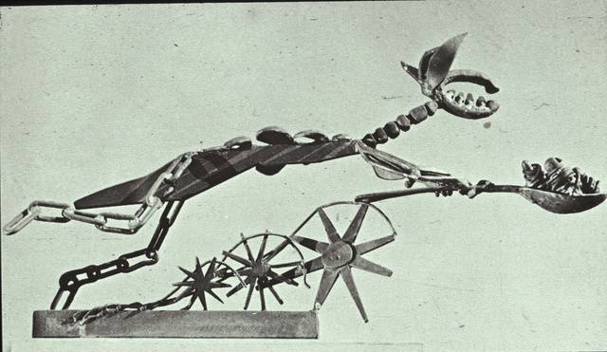
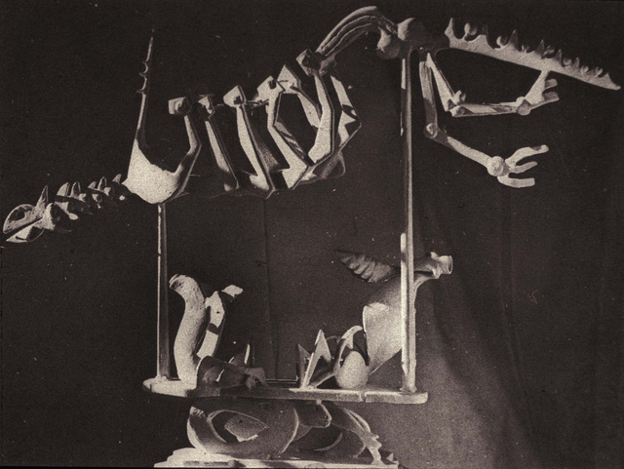
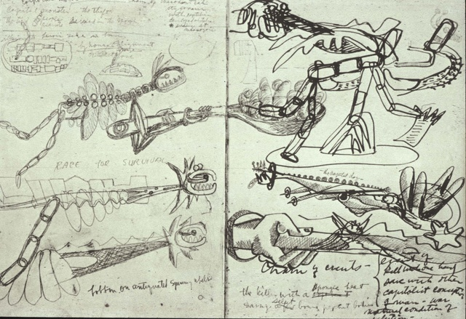
David Smith, (left) Jurassic Bird, painted steel, 1945
(right top) Specter of Profit, 1946, steel and stainless steel
(right below) Smith’s notebook sketches from the Museum of Natural History
Influence of Surrealism / constructed sculpture

Slide 23
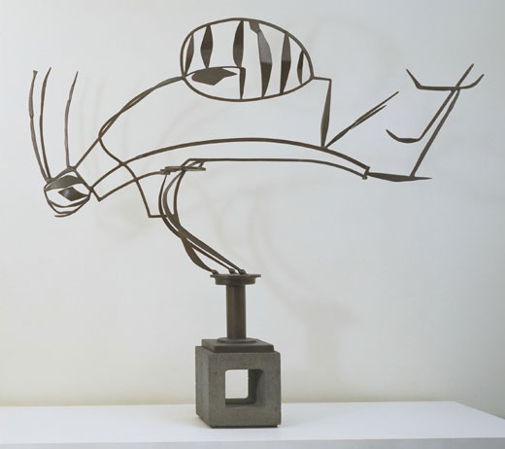
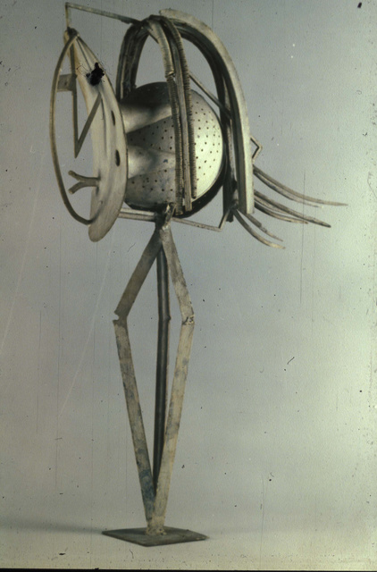
(left) David Smith, Australia, 1951, painted steel, 6' 7 x 8'12" x 16" (on cinder block base) Abstract Expressionism, “drawing in space”
(right) Pablo Picasso, Head of a Woman, 1933
Influence of Constructed Sculpture and Surrealism

Slide 24
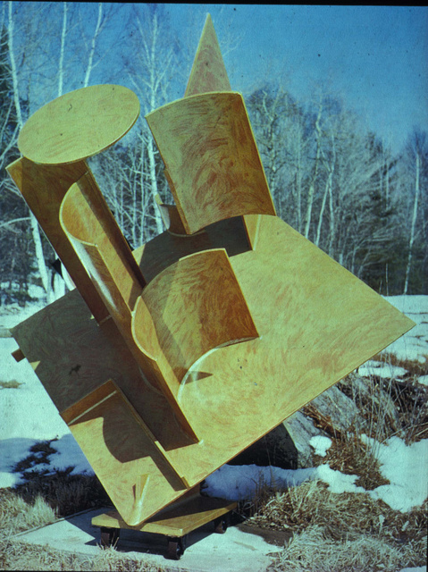
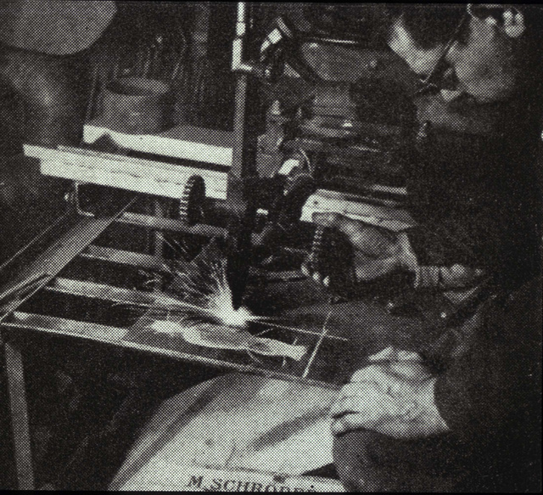
David Smith, Zig IV, painted steel, 1963
“What [steel] can do in arriving at form economically, no other material can do. The metal itself possesses little art history. What associations it possesses are those of this century: power, structure, movement, progress, suspension, destruction, and brutality."
David Smith

Slide 25
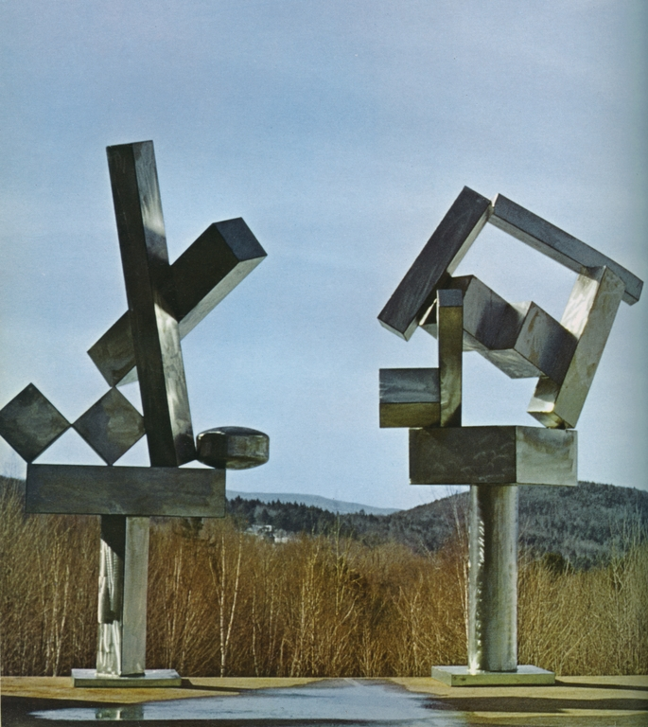
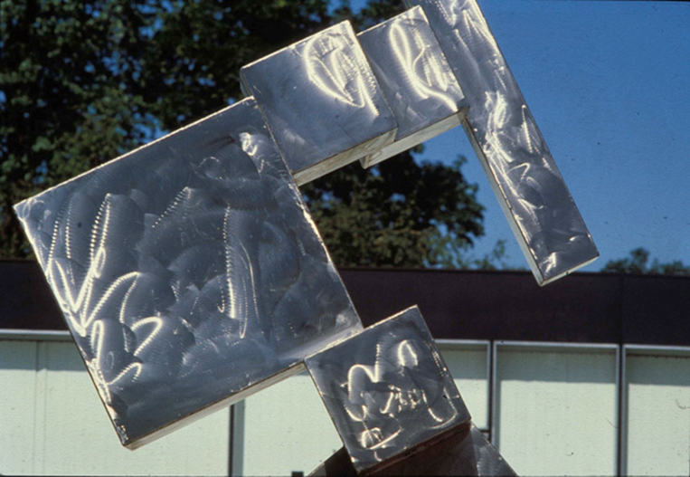

(left) David Smith, Cubi XIX, 1964, burnished stainless steel, 9’5” x 4’10” x 3’4”, Tate Gallery, London. (This is the sculpture illustrated in your textbook.)

Slide 26
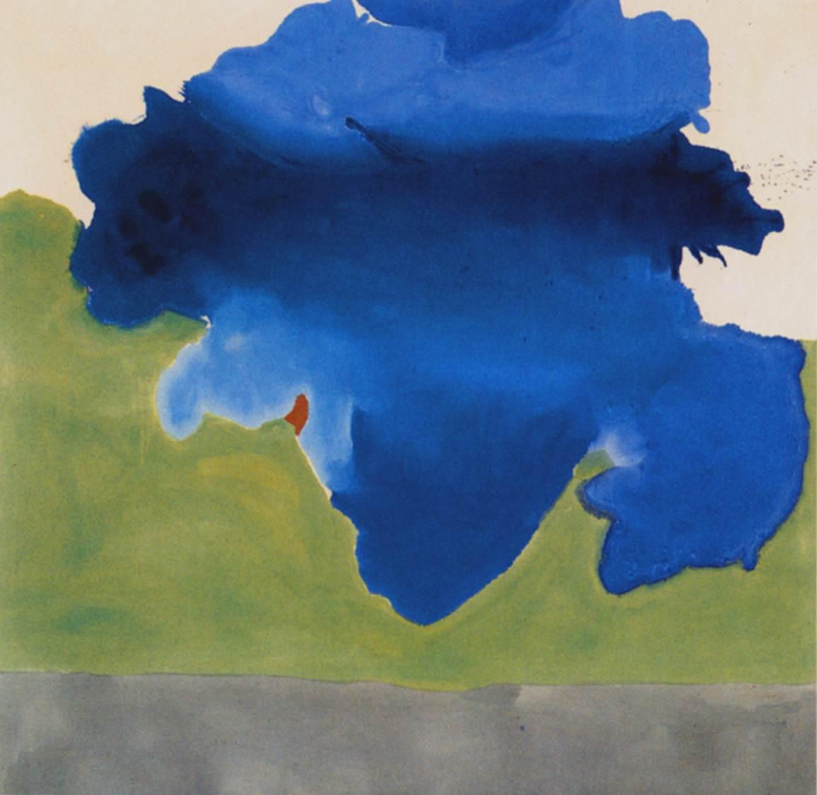
Post-Painterly Abstraction or Color Field Painting
Helen Frankenthaler (US, 1923-2011) The Bay, 1963, Acrylic on canvas, 6’9” x 6’10” Detroit Institute of Arts
Note: the image in your textbook is
incorrectly positioned.

Slide 27
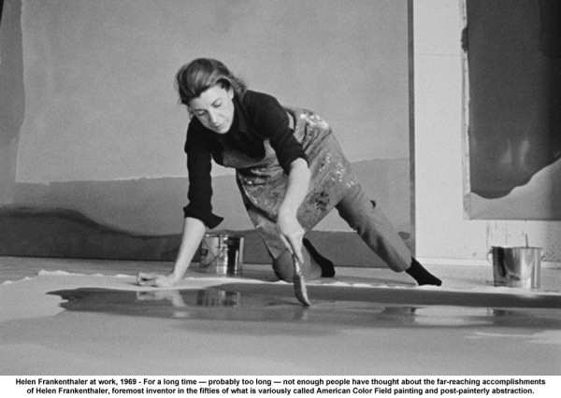
Helen Frankenthaler painting, 1969. Post-Painterly Abstraction or Color Field painting. No emotional content like Abstract Expressionism; formal issues only.

Slide 28
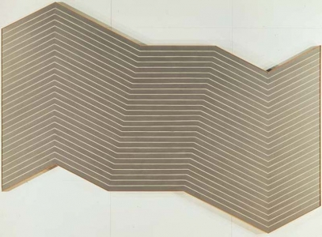
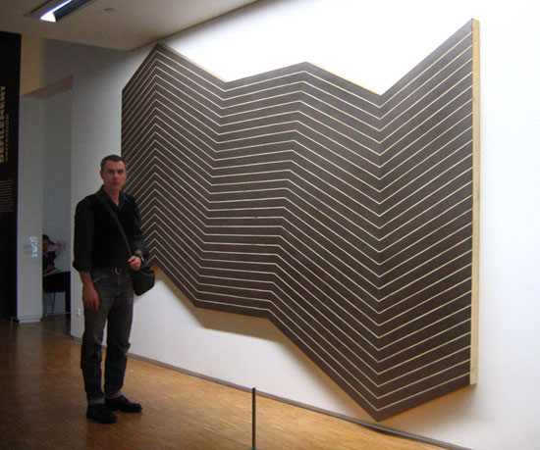
FRANK STELLA (US b. 1936), Mas o Menos (More or Less), 1960, Metallic powder in acrylic emulsion on canvas. Post Painterly Abstraction and Minimalism

Slide 29
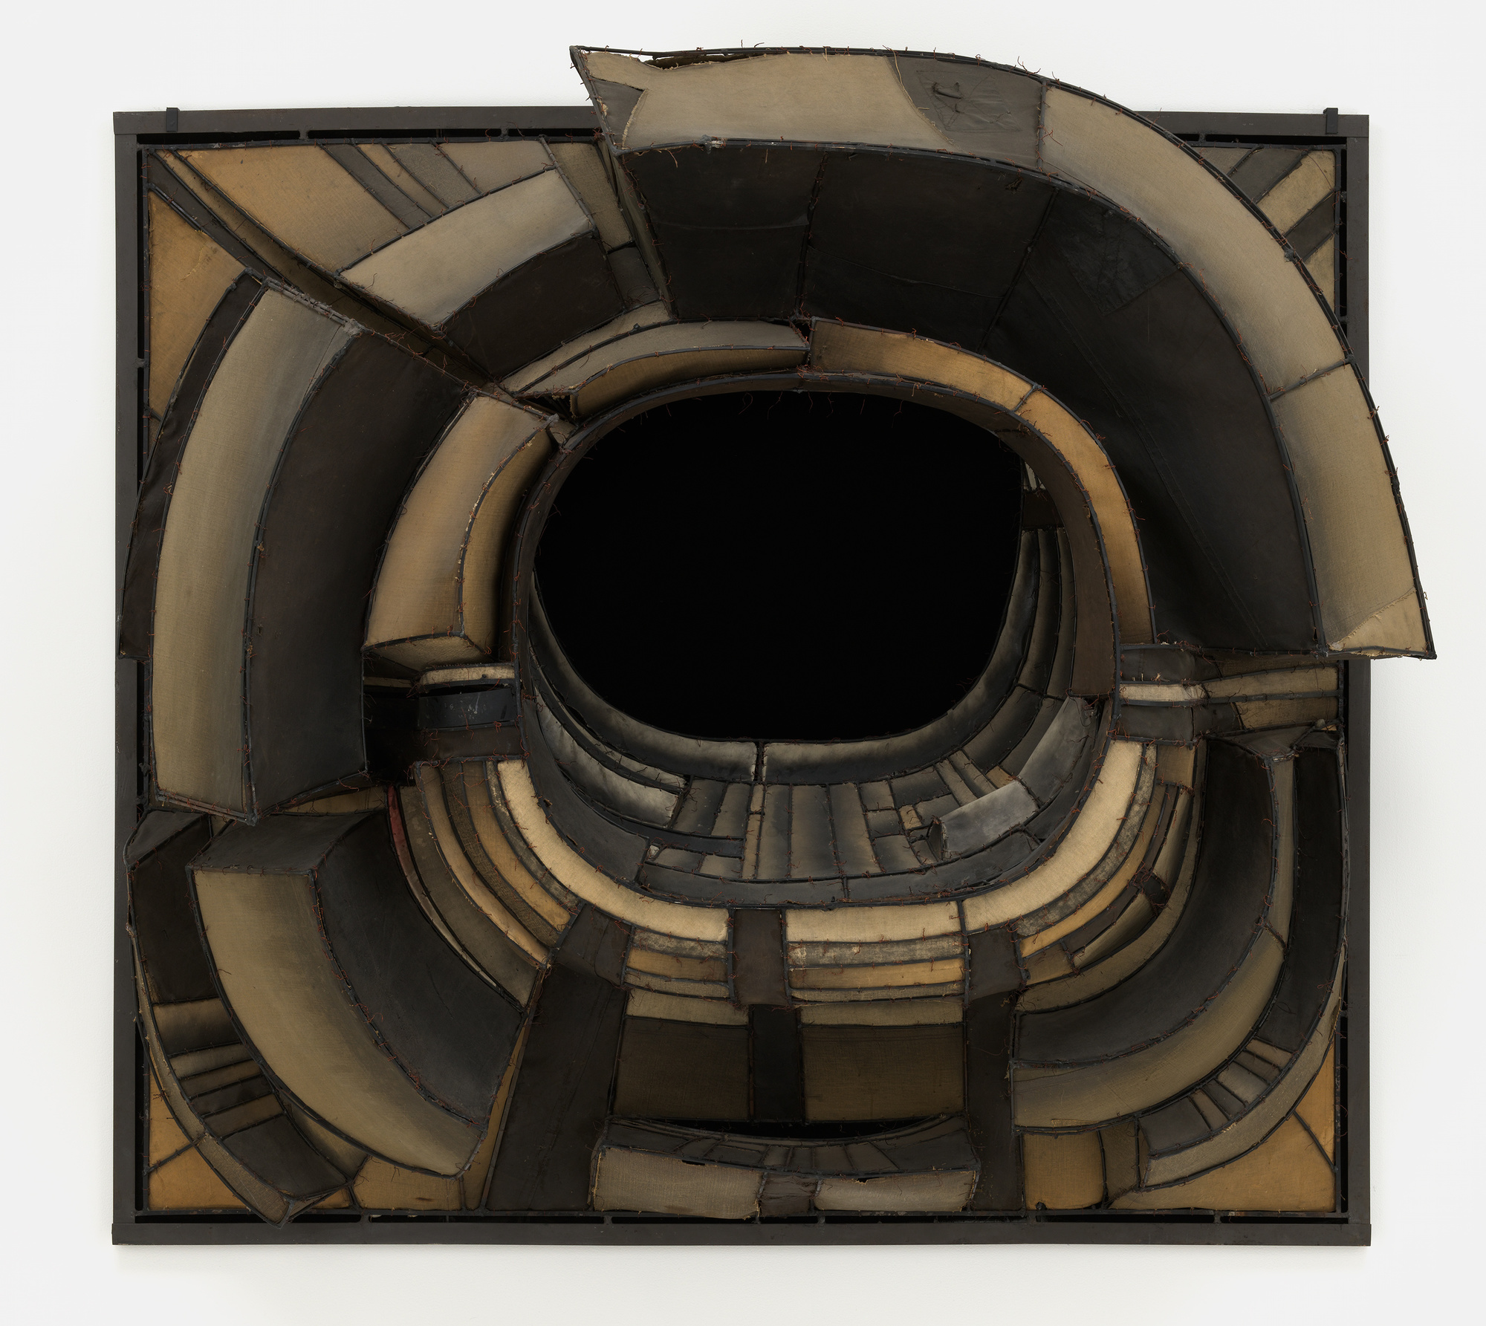
Lee Bontecou (U.S., b. 1931), Untitled, 1961, welded steel, canvas, wire, cow hide, black velvet
Museum of Modern Art, NYC

Slide 30
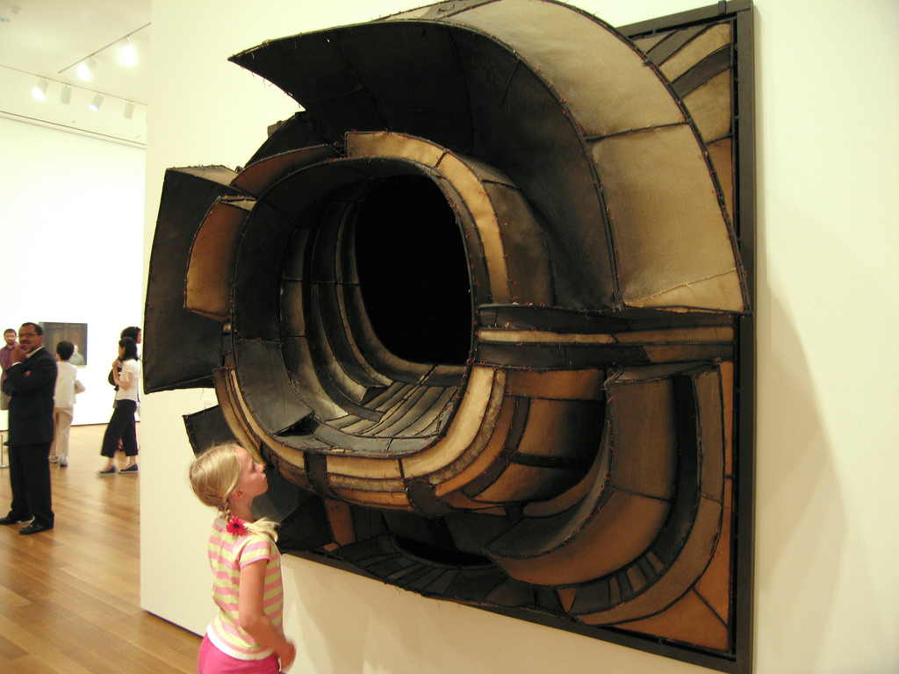
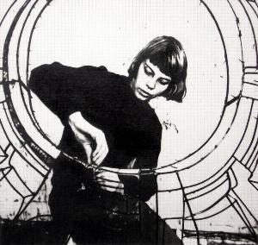
Lee Bontecou (U.S., b. 1931), Untitled, 1961, welded steel, canvas, wire, cow hide, black velvet
Museum of Modern Art, NYC
Bontecou attaching canvas to a
welded steel frame, c. 1960

Slide 31


